Slide 1
Workshop 2:
Basic Javascript
By Hui Xin | Sin Yan

Slide 2
Table of Contents
Operators and Variables
Loops
1
6
Conditionals
Iterators
2
7
Functions
Objects
3
8
Scope
4
Arrays
5
10

Slide 3
Pre-Event Preparations
Code Editor/IDE
Atom (preferred)
VS Code
These slides/code for your reference:
https://github.com/nyp-lit/webdevcourse2022
Notes:
Send into the chat:
here’s the link to all workshop materials: https://github.com/nyp-lit/techweek2021 https://github.com/nyp-lit/webdevcourse2022

Slide 4
Part 1: Recap

Slide 5
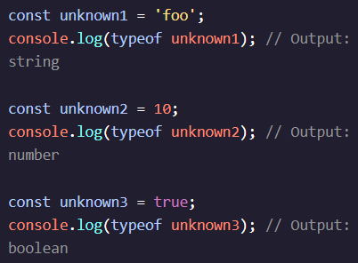
Introduction
console.log() - to write and print codes into the console
document.write() - to write codes on a HTML File
Data Types
Number - Integers and Floats
String
Boolean - True and False
Null
Undefined
Symbol
Object- Collections of related data
Use typeof operator to check the data type
Notes:
Send into the chat:
here’s the link to all workshop materials: https://github.com/nyp-lit/techweek2021 https://github.com/nyp-lit/webdevcourse2022

Slide 6
Operators
Arithmetic
+ - Add
- - Subtract
* - Multiply
/ - Divide
% - Reminder
= - Assignment
Assignment
+= - Add Subtract - a += 1, short for a = a + 1
-= - Sub and Equal - a -= 1, short for a = a - 1
*= - Multiply and Equal - a *= 1, short for a = a * 1
/= - Divide and Equal - a /= 1, short for a = a / 1
Increment and Decrement
++ - Increment
- - - Decrement
String Concatenation and String Interpolation
+ - Concatenation - Add strings and variables together
${ } - Interpolation - insert variables to strings(replace ‘ ‘ with ` `)(located next to 1 key)
Property
. - retrieve property info by appending a period to a string
Notes:
Send into the chat:
here’s the link to all workshop materials: https://github.com/nyp-lit/techweek2021 https://github.com/nyp-lit/webdevcourse2022

Slide 7
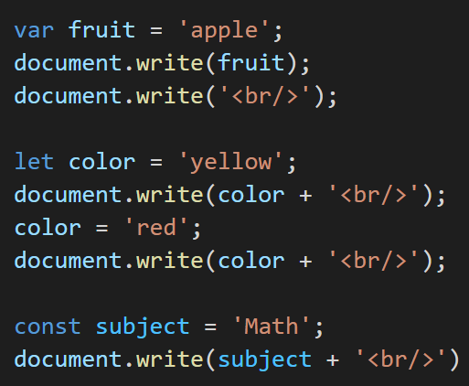
Variables
There are 3 ways to create/declare a variable.
var - assign a variable to var using the assignment operator(=)
let - declare a variable without assigning a value, signal that the variable can be reassigned to a different value
const - must be assigned a value when declared(SyntaxError), cannot reassign const variable(TypeError)
Notes:
Send into the chat:
here’s the link to all workshop materials: https://github.com/nyp-lit/techweek2021 https://github.com/nyp-lit/webdevcourse2022

Slide 8
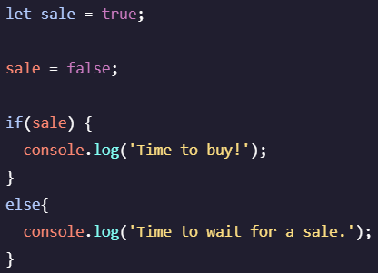
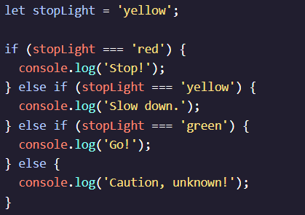
Conditionals - If,Else,Else If
if - execute if the condition is true for if statement
else if - execute if else if statement is true
else - none of the statements above are true
Notes:
Send into the chat:
here’s the link to all workshop materials: https://github.com/nyp-lit/techweek2021 https://github.com/nyp-lit/webdevcourse2022

Slide 9
Conditionals - Operators
Comparison
< - less than
> - greater than
<= - less than or equal to
>= - greater than or equal to
=== - is equal to
!== - is not equal to
Logical
&& - and
|| - or
! - not
Notes:
Send into the chat:
here’s the link to all workshop materials: https://github.com/nyp-lit/techweek2021 https://github.com/nyp-lit/webdevcourse2022

Slide 10
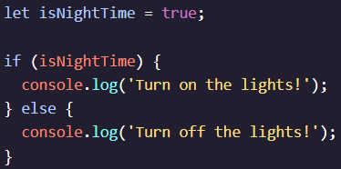

Conditionals - Ternary Operator
Simplify an if else statement.
Two expressions follow the ? and are separated by a colon.
If the condition is true, the first expression is executed.
If the condition is false, the second expression is executed.
Notes:
Send into the chat:
here’s the link to all workshop materials: https://github.com/nyp-lit/techweek2021 https://github.com/nyp-lit/webdevcourse2022

Slide 11
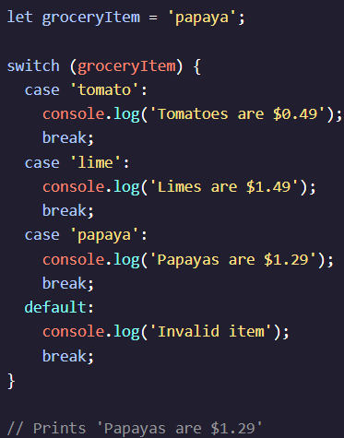
Conditionals - Switch
provides an alternative syntax for easy reading and writing
switch - initiates the statement
case - check if expression match the specific value
break - exit the block and not execute any codes
default - executed if none of the cases are true.
Notes:
Send into the chat:
here’s the link to all workshop materials: https://github.com/nyp-lit/techweek2021 https://github.com/nyp-lit/webdevcourse2022

Slide 12
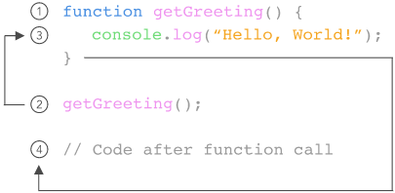
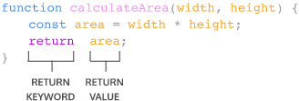
Functions
Creating
A function can be declared using the function keyword
A function body with block of statements(including a return statement) to perform a specific task
Parameters can be added into the function.
Calling
Call a function to execute the codes in a function
Type the function name followed by a ().
Call the same function as many times as we want.
Arguments can be passed into the function.
Notes:
Send into the chat:
here’s the link to all workshop materials: https://github.com/nyp-lit/techweek2021 https://github.com/nyp-lit/webdevcourse2022

Slide 13
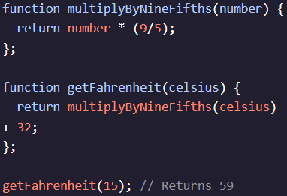
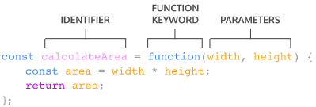
Functions
Helper
Return value of a function inside another function
Call functions within a function
Expression
Function name is omitted
Function expression is stored in a variable
Notes:
Send into the chat:
here’s the link to all workshop materials: https://github.com/nyp-lit/techweek2021 https://github.com/nyp-lit/webdevcourse2022

Slide 14
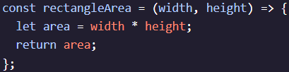
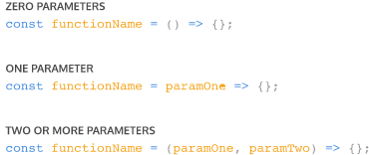
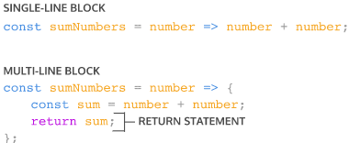
Functions
Arrow
Short way to write function using arrow notation ()=>
Concise Body
Several ways to refactor an arrow function
Notes:
Send into the chat:
here’s the link to all workshop materials: https://github.com/nyp-lit/techweek2021 https://github.com/nyp-lit/webdevcourse2022

Slide 15
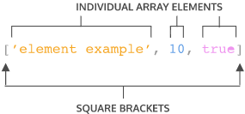
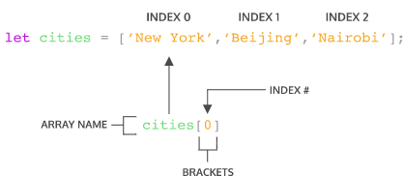
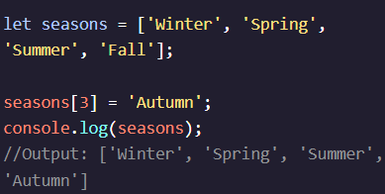
Arrays
Created by wrapping items in square brackets [].
Can store elements of any data type
Assign a variable to an array
Accessing Elements
Access each element using their index
Updating Elements
Update the value of each element
For arrays assigned to a const variable, the elements in the array remain mutable, but reassignment of new arrays or different values are not allowed.
Notes:
Send into the chat:
here’s the link to all workshop materials: https://github.com/nyp-lit/techweek2021 https://github.com/nyp-lit/webdevcourse2022

Slide 16
Arrays - Property and Method
Property
.length - number of items in an array
Methods
.push() - add items to the end of an array
.pop() - remove the last item in an array
.shift() - remove the first item in an array
.unshift() - add items to the front of an array
.slice() - extracts a section of array and returns a new array
.indexOf - return the index of an element
Notes:
Send into the chat:
here’s the link to all workshop materials: https://github.com/nyp-lit/techweek2021 https://github.com/nyp-lit/webdevcourse2022

Slide 17
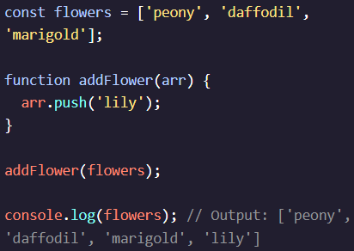
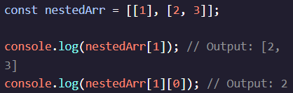
Functions and Nested Arrays
Arrays and Functions
Declare a function to make changes to an array
Call a function to execute these changes
Nested Arrays
Nested arrays can also be created by having arrays as items of an array.
Access the nested arrays using bracket notation [ ] with the index value.
First Index to access an array, second index to access elements of that array.
Notes:
Send into the chat:
here’s the link to all workshop materials: https://github.com/nyp-lit/techweek2021 https://github.com/nyp-lit/webdevcourse2022

Slide 18
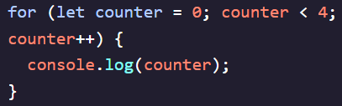
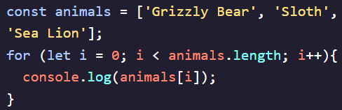
Loops - For Loop
For Loop
Initialization - start the loop and declare iterator variable
Stopping condition - evaluated against the iterator variable. If true, code will run. If false, the coe will not run.
Iteration statement - update the iterator variable on each loop
Loop through Arrays
Use the for loop to loop through each element in an array
Notes:
Send into the chat:
here’s the link to all workshop materials: https://github.com/nyp-lit/techweek2021 https://github.com/nyp-lit/webdevcourse2022

Slide 19
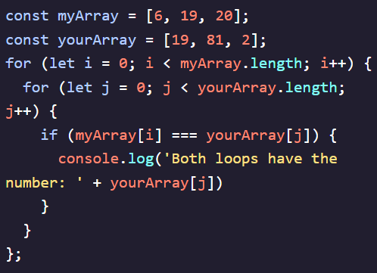
Loops - For Loop
Nested Loops
Loop running inside another loop
Compare elements in two arrays
Inner loop will run for each round of the outer loop
Notes:
Send into the chat:
here’s the link to all workshop materials: https://github.com/nyp-lit/techweek2021 https://github.com/nyp-lit/webdevcourse2022

Slide 20
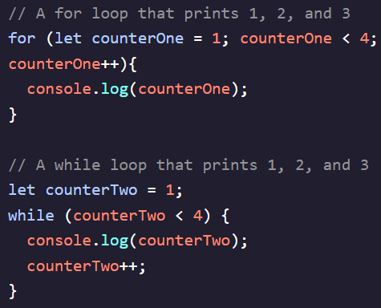
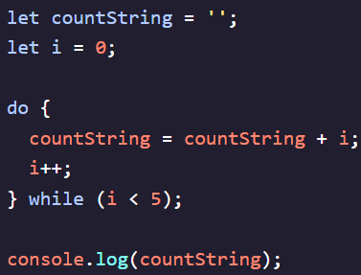
Loops - While Loop
While Loop
Ideal when we do not know how many times the loop should run
Incrementation to avoid any infinite loops.
Loop will keep running until the condition is false.
Do While
A piece of code to run at least once and then loop based on a condition after its initial run.
Do a task once and keep doing it until the condition is not met.
Break
Break can be use in loops to stop the code execution and exit the program
Notes:
Send into the chat:
here’s the link to all workshop materials: https://github.com/nyp-lit/techweek2021 https://github.com/nyp-lit/webdevcourse2022

Slide 21
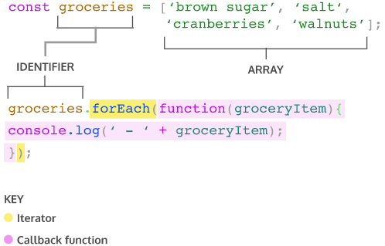
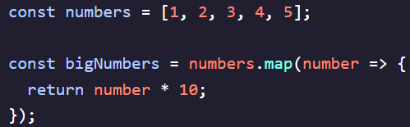
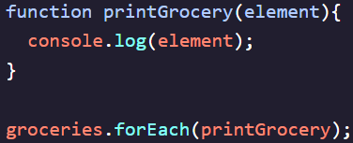
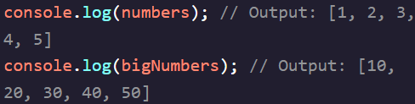

Iterators - Methods
.forEach() - execute the same code for each element of an array
.map() - take an argument of a callback function and return a new array
Notes:
Send into the chat:
here’s the link to all workshop materials: https://github.com/nyp-lit/techweek2021 https://github.com/nyp-lit/webdevcourse2022

Slide 22
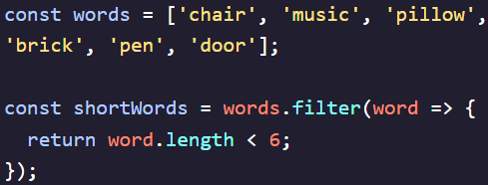
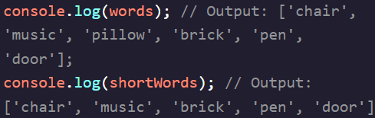
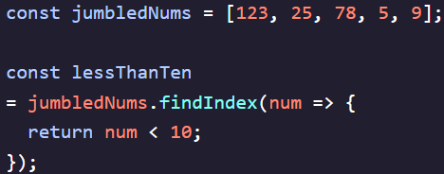
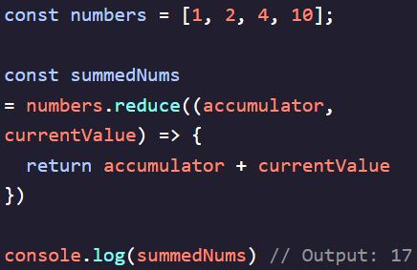


Iterators - Methods
.filter() - returns a new array after filtering some elements from the original array.
.findIndex() - return the index of an element in a array
.reduce() - return a single value after iterating through elements of an array
Notes:
Send into the chat:
here’s the link to all workshop materials: https://github.com/nyp-lit/techweek2021 https://github.com/nyp-lit/webdevcourse2022

Slide 23
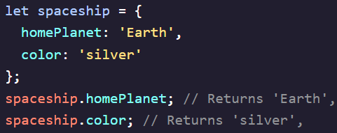
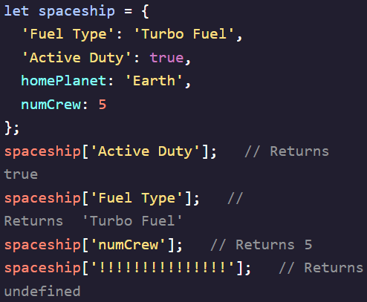
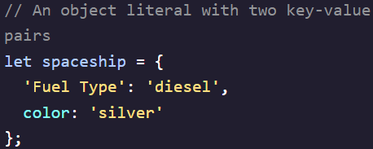
Objects
Creating
Created with object literal and key-value pairs in the code block
Accessing
Use dot notation/bracket notation to access the value of the key value pair
Notes:
Send into the chat:
here’s the link to all workshop materials: https://github.com/nyp-lit/techweek2021 https://github.com/nyp-lit/webdevcourse2022

Slide 24
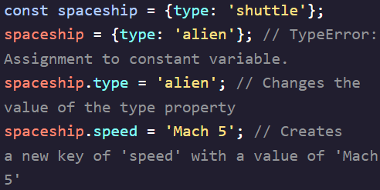
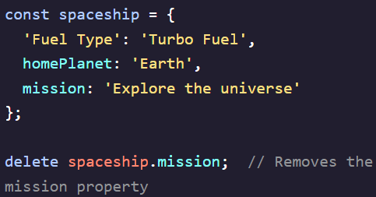

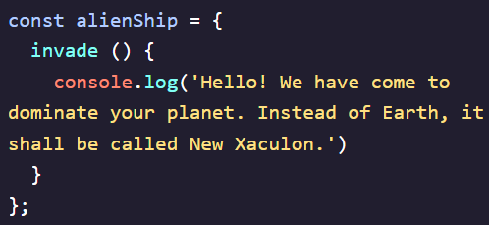
Objects
Property Assignment
Use dot/bracket notation or assignment operator to add new key-value pairs or change an existing property
Use delete operator to delete a property from an object.
Methods
Create a key-value pairs with functions as the value
Use the dot operator to invoke the object method
Notes:
Send into the chat:
here’s the link to all workshop materials: https://github.com/nyp-lit/techweek2021 https://github.com/nyp-lit/webdevcourse2022

Slide 25
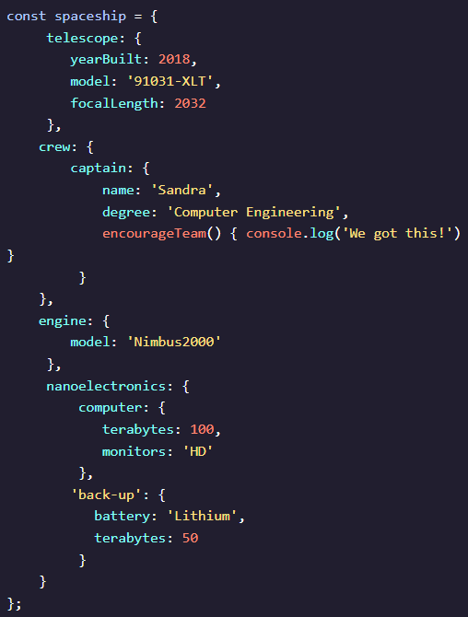

Objects
Nested Objects
Object as a property of another object.
Chain operators to access nested properties
Notes:
Send into the chat:
here’s the link to all workshop materials: https://github.com/nyp-lit/techweek2021 https://github.com/nyp-lit/webdevcourse2022

Slide 26
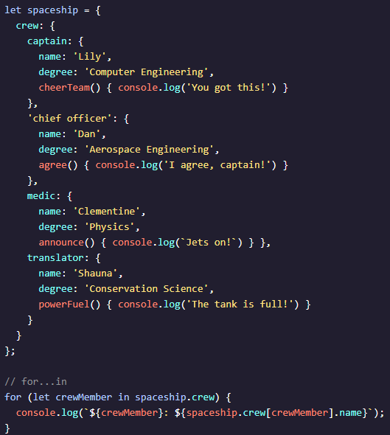
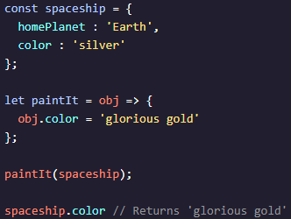
Objects
Pass by Reference
Calling a function by passing the reference of the variable as an argument.
Functions which change object properties mutate the object permanently.
Looping through Objects
Use for in to iterate through objects
Notes:
Send into the chat:
here’s the link to all workshop materials: https://github.com/nyp-lit/techweek2021 https://github.com/nyp-lit/webdevcourse2022

Slide 27
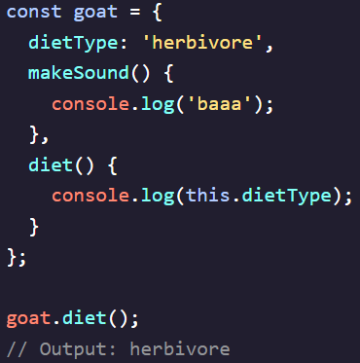
Advanced Objects
This keyword
Reference the calling object which provide access to its properties
Privacy
Use an underscore to mean that the property should not be altered
Notes:
Send into the chat:
here’s the link to all workshop materials: https://github.com/nyp-lit/techweek2021 https://github.com/nyp-lit/webdevcourse2022

Slide 28
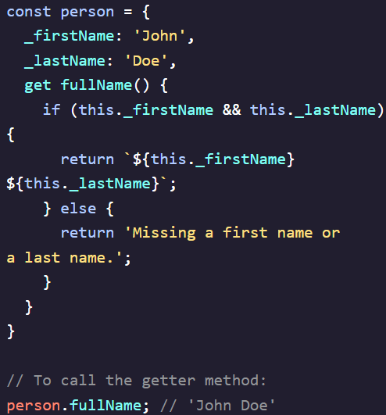
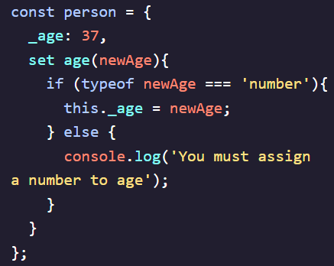
Advanced Objects
Getter
Methods that get and return internal properties of an object
Setter
Methods that reassign values of existing properties within an object.
Notes:
Send into the chat:
here’s the link to all workshop materials: https://github.com/nyp-lit/techweek2021 https://github.com/nyp-lit/webdevcourse2022

Slide 29
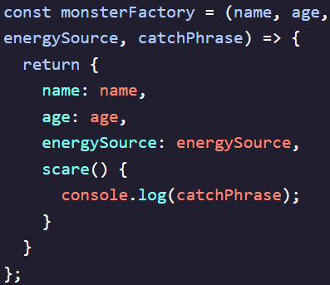
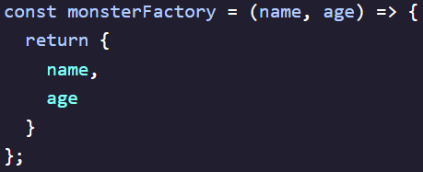

Advanced Objects
Factory Functions
Create many instances of an object
Property Value Shorthand
Short version of a factory function that helped to create objects
Notes:
Send into the chat:
here’s the link to all workshop materials: https://github.com/nyp-lit/techweek2021 https://github.com/nyp-lit/webdevcourse2022

Slide 30
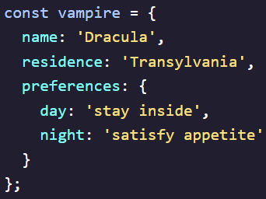

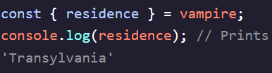
Advanced Objects
Destructured Assignment
Create a variable with the object’s key name in curly braces {}
Built-in Object Methods
Object.keys() - returns an array of a given object’s enumerable property names
Object.assign() - copy all enumerable properties from source objects to target object. Returns modified target object.
Object.entries() - returns an array of a given object’s enumerable string-keyed property
Notes:
Send into the chat:
here’s the link to all workshop materials: https://github.com/nyp-lit/techweek2021 https://github.com/nyp-lit/webdevcourse2022

Slide 31
Math
Methods
Math.abs() - returns the absolute value of a number
Math.ceil() - rounds up a number up to the next largest integer
Math.floor() - returns the larger integer less than or equal to a number
Math.log() - returns the natural logarithm of x
Math.max() - returns the largest of zero or more numbers
Math.min() - returns the smallest of zero or more numbers
Math.pow() - passes 2 arguments, base and exponent to return base ^ exponent
Math.random() - returns a pseudo-random number between 0 and 1
Math.round() - returns the value of a number rounded to the nearest integer
Math.sign() - returns the sign of the number ( indicate if number is positive,negative, or zero)
Math.sqrt() - returns the positive square root of a number
Math.trunc() - returns the integer part of a number without any decimal digits
Notes:
Send into the chat:
here’s the link to all workshop materials: https://github.com/nyp-lit/techweek2021 https://github.com/nyp-lit/webdevcourse2022

Slide 32
Part 2: Knowledge Check
Notes:
https://www.menti.com/pu7spuiw3r

Slide 33

Scan the QR Code to enter the kahoot quiz

Slide 34
Part 3: Practical
Notes:
https://www.menti.com/pu7spuiw3r

Slide 35


Thank you!
Do you have any questions?
Hop over to the get-support voice channel! We will be there till the end of the event, or feel free to drop us a message in get-support text channel
https://nyp-lit.github.io/
@nyp_lit

